Slide 1
US CRM Linguistic to CRM Research
Presented by
Christopher Skinner
www.christopherskinner.com
September 30, 2019
Notes:
Christopher Skinner Research September 30, 2019

Slide 2
Introduction / Purpose
Notes:
Hypothesis

Slide 3
Purpose
Understanding decisions; why people decide, using large population sets, to predict outcomes
Better understand the early stages of the customer journey
We can’t measure thoughts but we can find ways to create theories of decision making
Connecting to purchase data may validate the research
Online is a limited representations of why we decide
There are many use cases for linguistic based technology to expand sales or cut waste

Slide 4
Results – early look
Notes:
Hypothesis

Slide 5
Results
Financial Organization – Most sales and profits are clusters to a limited set of temperaments
Notes:
Financial Organization

Slide 6
Data sets
Arguments
Notes:
Hypothesis

Slide 7
The US CRM is comprised of human activities (HA), demographics, financial data, and location based data. 243,346,432 people x 450 data points = 109,505,894,400 data points.
Other country CRMs are available.
There are 207,056,529 unique location records.
This also includes 107 million automobile files.
Notes:
The US CRM is comprised of human activities, demographics, financial data, and location based data. 243,346,432 people x 450 data points = 109,505,894,400 data points.

Slide 8
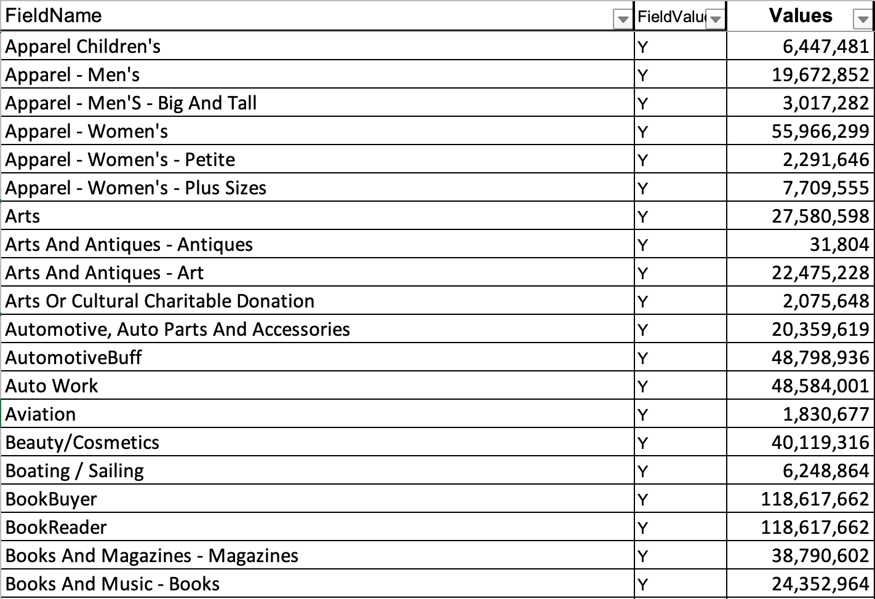
Human activities we measure
americanexpresscard
americanexpressgoldpremium
animalwelfarecharitabledonation
apparelchildrens
apparelmens
apparelwomens
apparelwomenspetite
apparelwomensplussizes
arts
artsandantiquesantiques
artsandantiquesart
artsorculturalcharitabledonation
automotiveautopartsandaccessories
automotivebuff
autowork
aviation
beautycosmetics
boatingsailing
bookbuyer
bookreader
booksandmusicbooks
booksandmusicbooksaudio
broaderliving
campinghiking
career
careerimprovement
cats
charitabledonationsother
childrensapparelinfantsandtoddlers
childrensinterests
childrensproductsgeneral
childrensproductsgeneralbabycare
childrensproductsgeneralbacktoschool
christianfamilies
collectiblesandantiquesgrouping
collectiblesantiques
collectiblescoins
collectspecialfoodsbuyer
commonliving
communitycharities
computerowner
computinghomeofficegeneral
consumerelectronics
cookingenthusiast
cookingfoodgrouping
cookinggeneral
crafts
craftshobbmerchbuyer
creditcardholderunknowntype
creditcarduser
currentaffairspolitics
dietingweightloss
discovergoldpremium
donatesbymail
donatestoenvironmentalcauses
dvdsvideos
educationonline
electronicsandcomputingtvvideomoviewatcher
electronicscomputersgrouping
electronicscomputersgrouping
electronicscomputingandhomeoffice
environmentalissuescharitabledonation
equestrian
exerciseaerobic
exerciseenthusiast
exercisehealthgrouping
exerciserunningjogging
exercisewalking
femalemerchbuyer
fishing
foodsnatural
foodwines
gamesboardgamespuzzles
gamescomputergames
gaming
gardener
gardeningfarmingbuyer
gasdeptretailcardholder
gasolineorretailcardgoldpremium
generalcontributor
golfenthusiasts
grandchildren
healthandbeauty
healthinstitutioncontributor
highendappliances
hightechleader
historymilitary
homeandgarden
homedecoratingenthusiast
homefurnishingsdecorating
homeimprovementgrouping
homeliving
houseplants
huntingshooting
internationalaidcharitabledonation
investingactive
investingfinancegrouping
investment
investmentsforeign
investmentspersonal
investmentsrealestate
jewelry
luggage
mailorderbuyer
mailresponder
malemerchbuyer
mastercardgoldpremium
mastercardregular
membershipclub
militarymemorabiliaweaponry
motorcycling
moviecollector
moviemusicgrouping
musicalinstruments
musicavidlistener
musiccollector
musichomestereo
musicplayer
nascar
newsandfinancial
onlinepurchasingindicator
opportunityseekers
outdoorenthusiast
outdoorsgrouping
outdoorsportslover
parenting
photography
photographyandvideoequipment
politicalcharitabledonation
politicalcontributor
politicalliberalcharitabledonation
presenceofbankcard
presenceofcreditcard
presenceofgoldorplatinumcreditcard
presenceofpremiumcreditcard
presenceofupscaleretailcard
readingaudiobooks
readinggeneral
readinggrouping
readingmagazines
readingsciencefiction
religiouscontributor
religiousmagazine
sciencespace
scubadiving
selfimprovement
senioradultinhousehold
sewingknittingneedlework
singleparent
snowskiing
sohoindicator
spectatorsportsautomotorcycleracing
spectatorsportsbaseball
spectatorsportsbasketball
spectatorsportsfootball
spectatorsportshockey
spectatorsportssoccer
spectatorsportstvsports
sportsandleisure
sportsgrouping
sportyliving
sweepstakes
telecommunications
tennis
theaterperformingarts
travelandentertainmentcardholder
travelcruisevacations
traveldomestic
traveler
travelgrouping
travelinternational
tvcable
tvsatellitedish
upscaleliving
valuehunter
veteraninhousehold
veteranscharitabledonation
visagoldpremium
visaregular
workingwoman
youngadultinhousehold
youngmensapparel
youngwomensapparel
Theory: A human activity (HA) will contain common linguistic properties across large populations.
Test: By measuring millions of written words in articles, written by people who perform that activity, I found common patterns specific specific to each human activities.
Notes:
Theory: A human activity will contain common linguistic counts across large populations. Test: By measuring millions of written words per human activity category, I found common patterns specific specific to those categories.

Slide 9
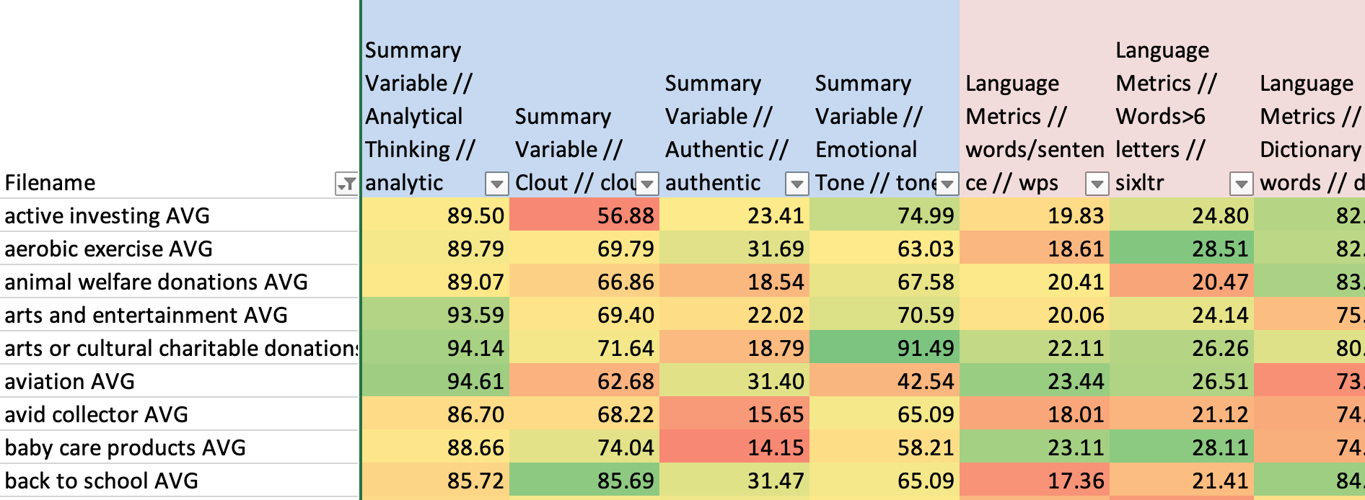
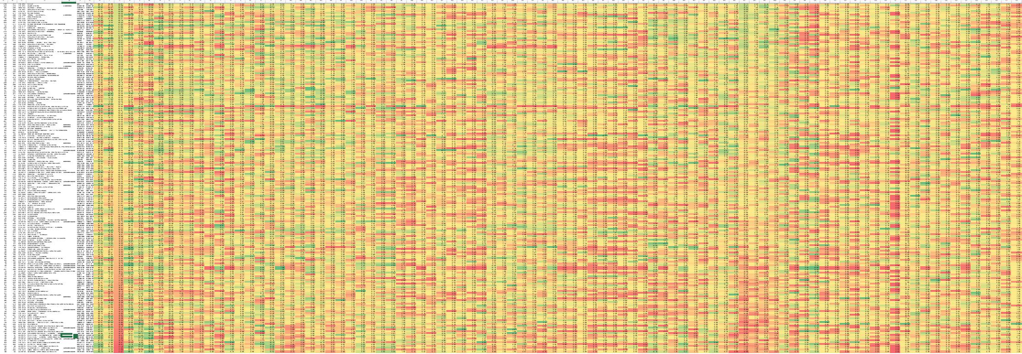
Table 6: Using LIWC, I mapped HA to linguistic categories (LA)
Notes:
Using LIWC, I mapped HA to linguistic categories (LA)

Slide 10
US CRM x LIWC(Table 6 data) = Traits and Big 5
Connection Engine
Organization CRM, Auto data, housing purchase data
Notes:
Organization CRM

Slide 11
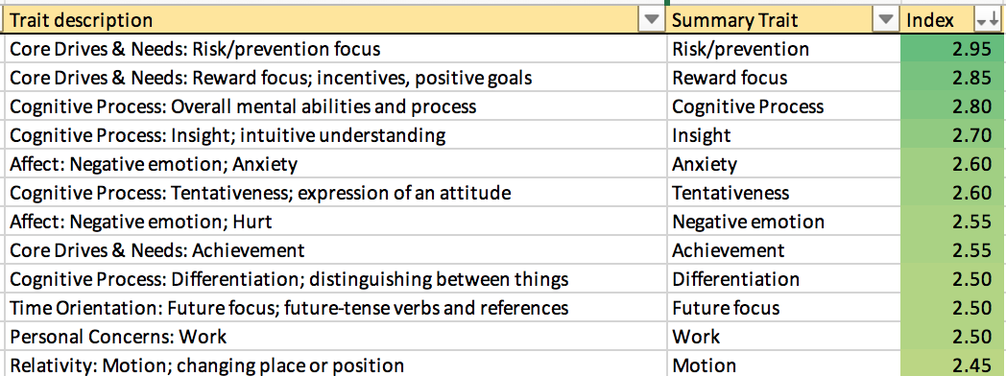
Results
Notes:
Auto warranty sales

Slide 12
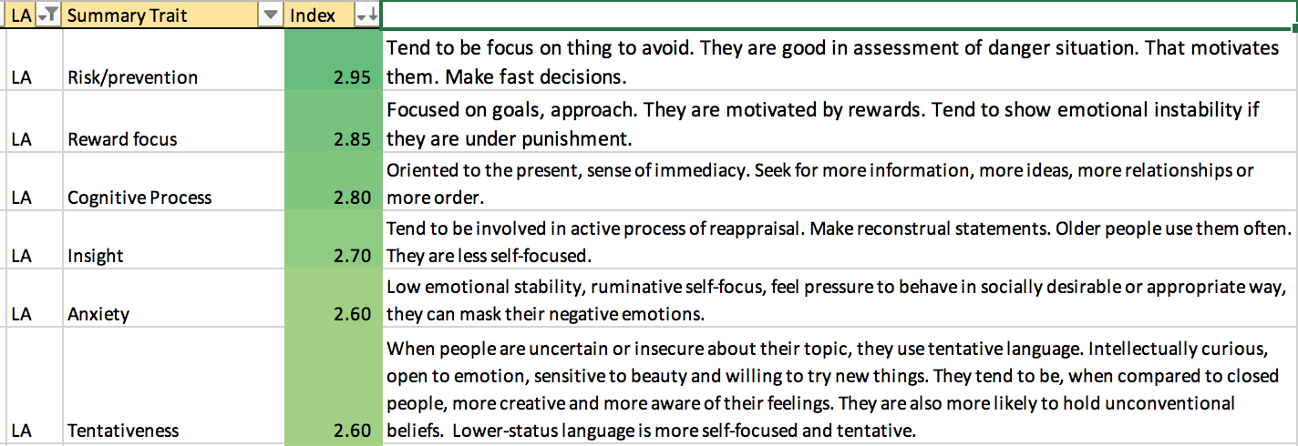
Results
Notes:
Organization CR

Slide 13
Results
Notes:
Financial Organization

Slide 14
Results
Notes:
Organization CR

Slide 15
Results
Notes:
Organization CR

Slide 16
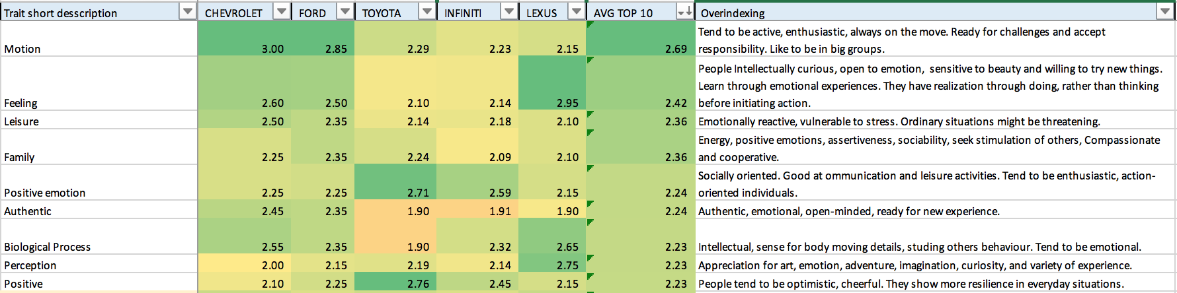
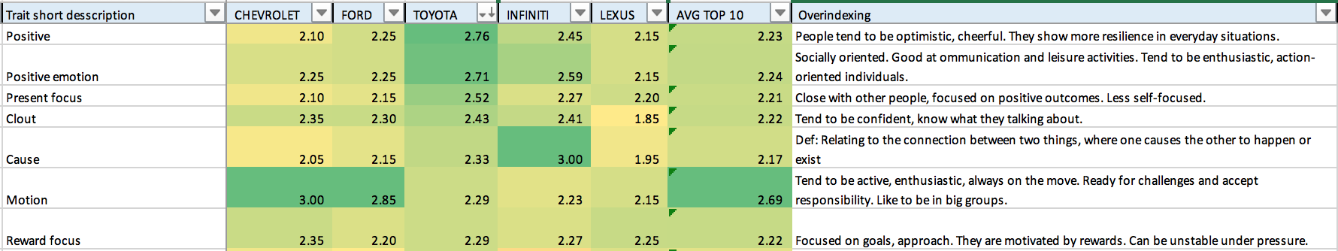
Iowa auto sales (year models, last 10 years)
Notes:
Iowa auto sales (year models, last 10 years)

Slide 17
Use Cases (Commercial): Existing Situation
Notes:
GOALS

Slide 18
Use Cases (Commercial): Existing Situation
-1% customer count, 17% more ross profit and 9% higher revenue by focusing on people types
Notes:
-1% customer count, 17% more ross profit and 9% higher revenue by focusing on people types

Slide 19
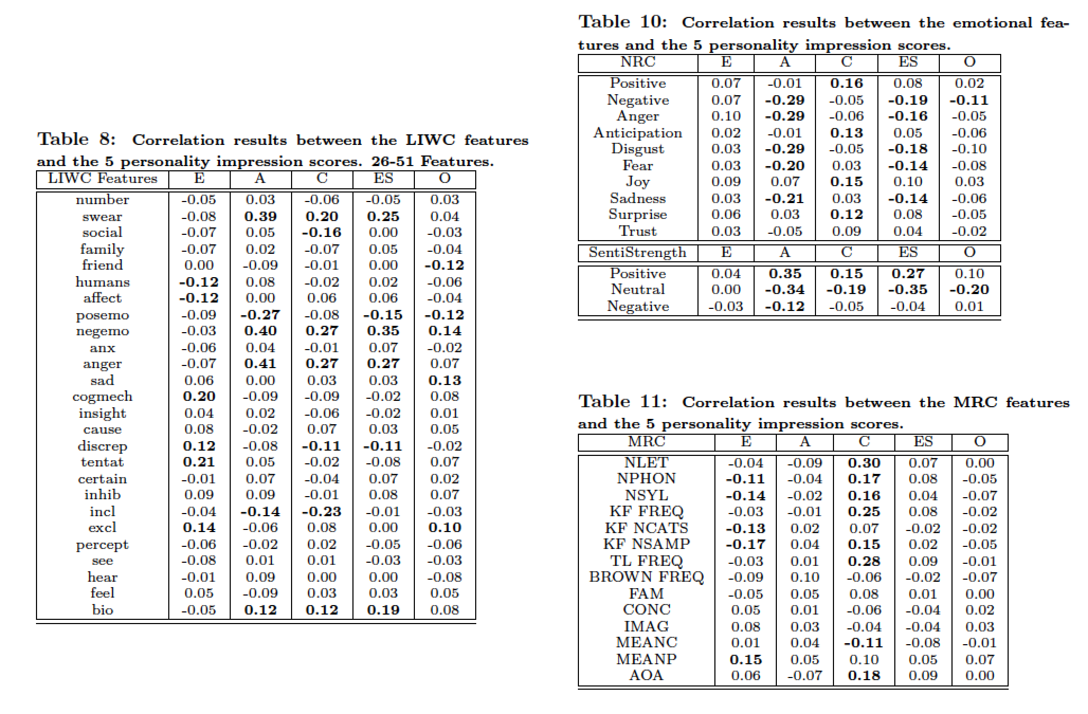
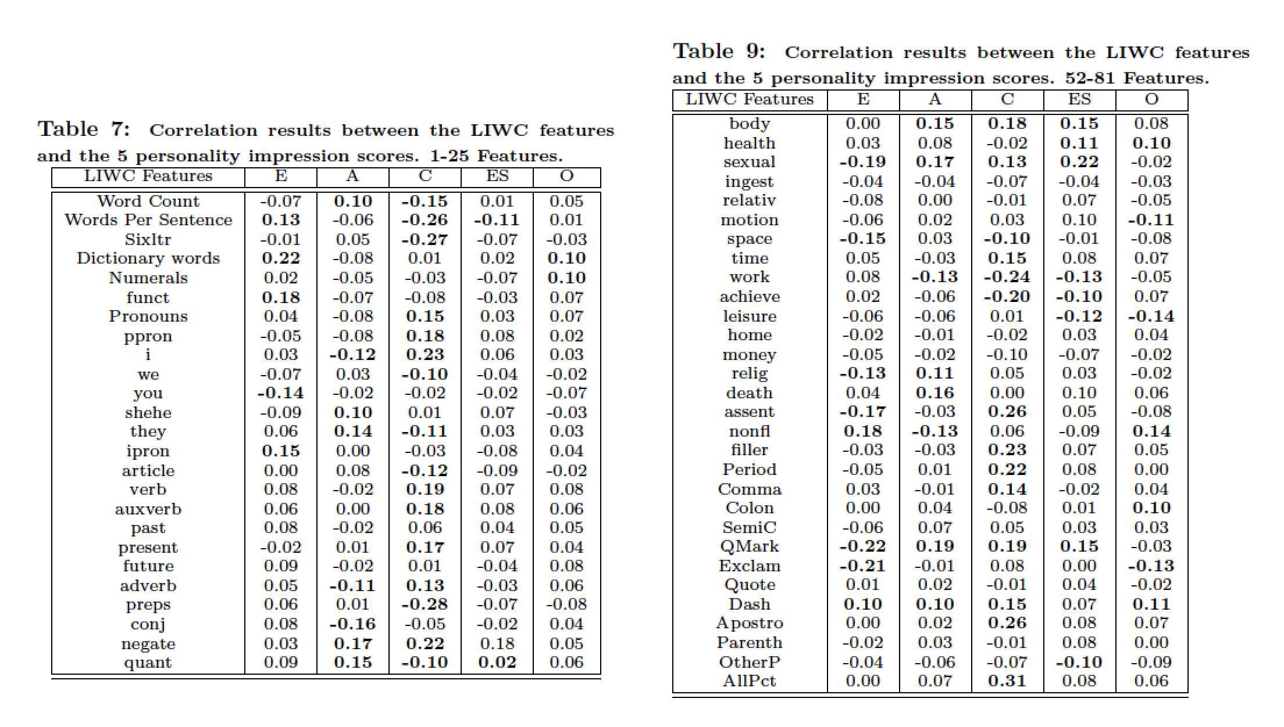
Current Research: LIWC to Big 5
Notes:
Organization CRM

Slide 20
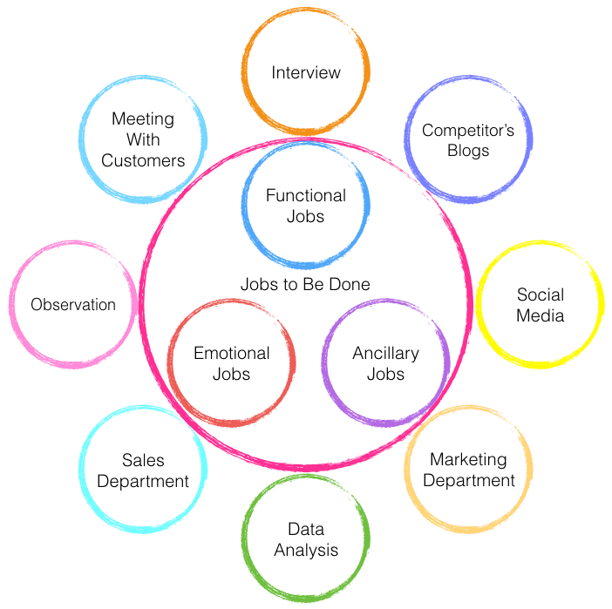

Research: JTBD
Notes:
Organization CRM

Slide 21
Possible Commercial Uses
Notes:
Organization CRM

Slide 22
Financial
Loyalty
Data Analytics
Yield more profit from your existing CRM
Treat them like your existing loyal customers
Create lookalike audiences based on delight and personality
CRM Optimization
Marketing
Customer Segmentation
Improved understanding of the customer
improve messaging, inform creative Personalize media on a 1:1 basis
What delights some people and what does not?
CMS Optimization
Improve conversion rates

Slide 23
Your
CRM
U.S.
CRM
OUTPUT
CMS
CRM
Email, web, and app
segmentation
• Append sales messaging
• Create lookalike audiences
Media
• Email marketing
• 1:1 display and video
• Search density
• Direct mail
• Facebook audiences

Slide 24
Notes:
Organization CRM

Slide 25
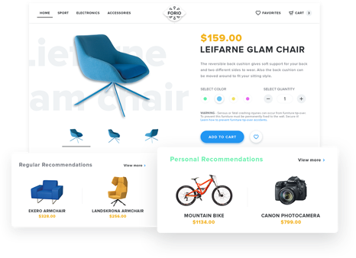
Today, online shopping is about price, discounts and free shipping.
Products suggestions are dull and tiring.
There’s little differentiation.
Put a chair in a shopping cart. And you get lots of suggestions to buy chair. This is not delighting and the ‘math’ does not maximize long term profits.
Predicting delight means suggesting different products that create intrigue.
What creates interest depends on the makeup of the person and their traits.

Slide 26
WHY WE EXIST
We empower businesses to capture customer delight like the in-store experience once did

Slide 27
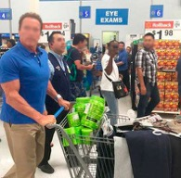
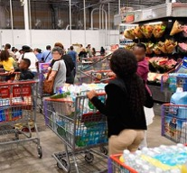
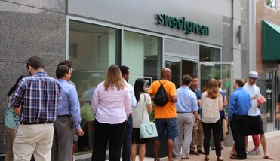
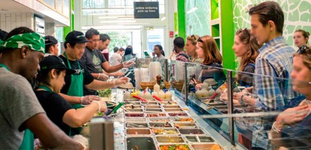
WHY WE EXIST
In-Store Customers were delighted at what they found and rewarded stores with results.
Basket sizes are bigger in stores
Conversion rate is 10x in stores

Slide 28
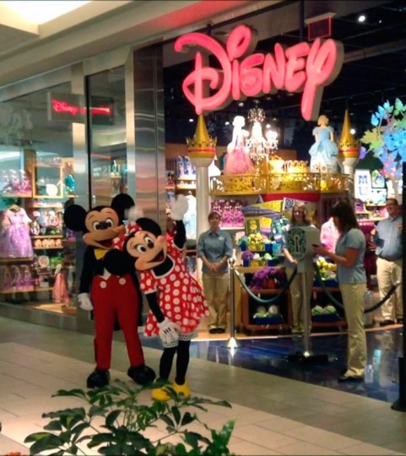

WHAT WE DO FOR YOU
Who else uses customer delight and personality data to define their customers?
“What if we showed new pictures to a new group of people, that we know the personality of, can we predict who will like which image?”
“..make sure you know your customer. Use your data so that it’s actually predictive, not just prescriptive.” — Suzy Deering, eBay
“Geography, age, and gender? We put that in the garbage heap,” — VP of product Todd Yellin
“Most important of all, are you delighting customers?” — Jeff Bezos

Slide 29
Christopher Skinner
www.ChristopherSkinner.com
504.259.6700
c@christopherskinner.com
Notes:
Christopher Skinner
www.ChristopherSkinner.com
504.259.6700
c@christopherskinner.com

