Slide 1
Market orientation gets the right product: Product orientation get the product right
Christopher skinner
cio
January 2015
Notes:
Market orientation gets the right product: Product orientation get the product right

Slide 2
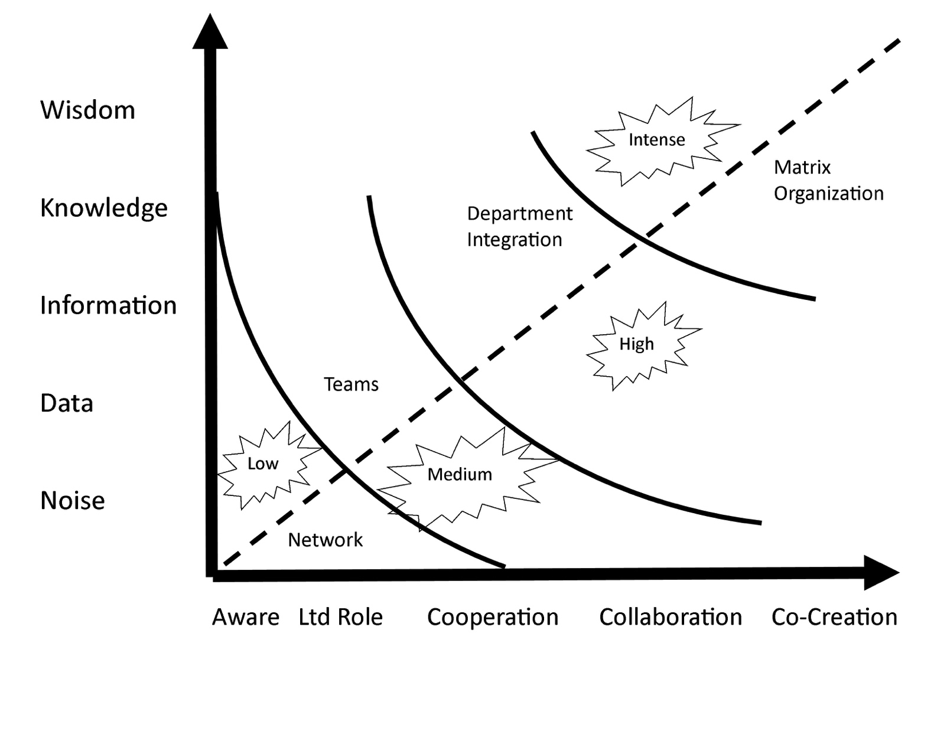
An agile organization combines progression of value with value of data to wisdom.
Wisdom x Co-Creation = Matrix organization
Notes:
The proper request must be answered with the right reply

Slide 3
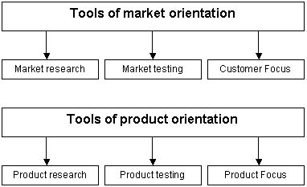
Notes:
The proper request must be answered with the right reply

Slide 4
A market orientated company focuses its products and services on the wants and needs of the customers.
A product orientated company focuses on its products.
A product orientated company example is GM, US Steel, Microsoft.
A market orientated company example is Apple, Starbucks, Uber

Slide 5
Shifting to market orientation drives market research and product ranges carefully designed to for customer preferences.
Successful companies recognize the importance of both approaches.
Products must start with the needs and wants of customers. But delivery of a profitable product depends on efficiency and quality in production.

Slide 6
Market orientation gets the right product: Product orientation get the product right.
Notes:
The proper request must be answered with the right reply

Slide 7
In the real world, market and product orientation are closely intertwined:
carry out market research into what consumers want
organize product research in line with the results of market research
constantly engage in qualitative market research about new ideas
test market new products in smaller market groups before launching them onto a wider market
evaluate ongoing customer perception of goods and services, in order to make improvements to technologies and product offerings.
Notes:
The proper request must be answered with the right reply

Slide 8
Notes:
The proper request must be answered with the right reply

Slide 9
Thank you
Notes:
Thank you

